Slide 1
Network Automation
Naisamuddin PK

Slide 2
Agenda
Automation introduction
Various Automation Tools
Introduction to SDN and SD-WAN
Introduction to Ansible
Basics of Python
Managing switches using SSH and Telnet
Add & Modify VLAN and Interface
Setting up SNMP Parameters
Update software on Multiple switches
Automatic Backup
LAB

Slide 3
Automation
What
How
Advantages
Use Case

Slide 4
Automation – What
Configuring machine to do something which is performing manually
Process of automating the configuration, management and operations of a computer network
Routine, Repeated and tedious task
Modern automation not mean by Scripting

Slide 5
Automation – How
Implemented by Combination of Software's and hardware's

Slide 6
Automation – Advantage
Reduce operating expenses
Reduce Total Cost of Ownership
Improve reliability and Service Levels
Improve execution speed

Slide 7
Automation – Use Case
User want Data Base Server
Legacy :
Create Request for OS & H/W
Hostname and IP address Reservation
Request for Switch port and VLAN assignment
Firewall Request
Follow up
New Gen:
Create one request from central Site using templates
Approve the Request
Automation will take care rest of activities

Slide 8
Automation – Technologies
Cloud Computing
Open Stack
Virtualization
SDN
NFV
SD-WAN

Slide 9
SDN –Software Defined Networking
What .?
Define Network By the software for the Software
An architecture to control not just a networking device but an entire network.
How.?
physical separation of the network control plane from the forwarding plane
control plane controls several devices
Centrally managed
Programmable

Slide 10
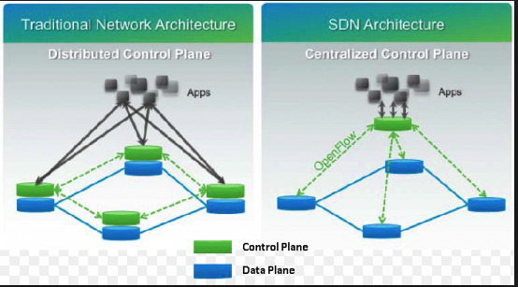
SDN- Architecture

Slide 11
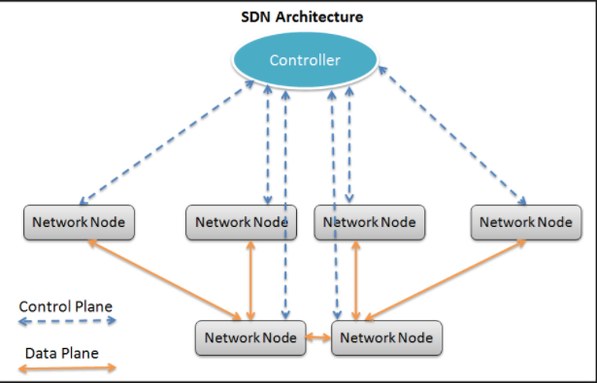
SDN- Architecture

Slide 12
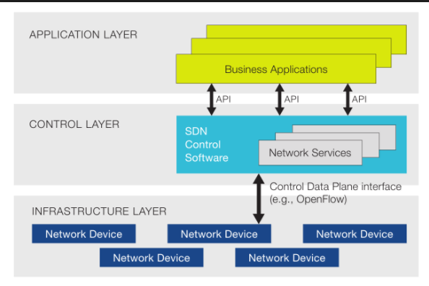
SDN- Architecture

Slide 13
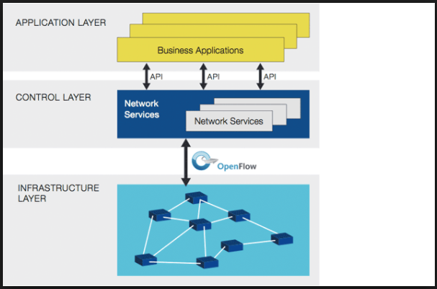
SDN - Architecture

Slide 14
SDN - Components
SDN Controller
Logically Centralize Entity
Communicating with Applications and network devices
Controlling and deciding data flow in network
OpenDayLight, Rye, and Flood Light
Open Flow
Protocol for communicating with Controller and Devices
Secure Communication
Multi Vendor support
Open Flow 1.3
API

Slide 15
Automation – Tools
Ansible
YAML
Cheff
Puppet
Python

Slide 16
Ansible
Open Source Automation Engine
Own by Redhat
No agents to install on remote machine
Support existing SSH modules
Automation language that approaches plain English
Easy to Use

Slide 17
PYTHON

Slide 18
Python
Created in 1989 by Guido Van Rossum
Interpreter based language
Object oriented
Portable
Powerful
Easy to learn
Combined features of Java and Perl
Python 2.7 is the stable version
Python 3.6 is the latest version

Slide 19
Python
Files are saving extension .py
Python implements indentation to differentiate Blocks
Variable types no need to declare
Google makes extensive use of python in web search and employ’s python creator
It is a scripting language

Slide 20
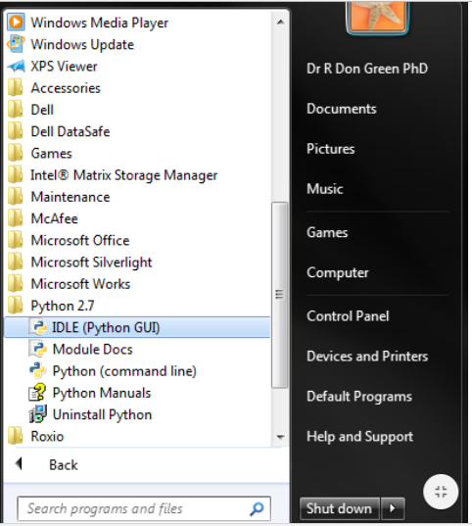
Installation
Download from following link
https://www.python.org/downloads/windows/

Slide 21
Basic task
Printing a word :
>>>print (“Hello World”)
Reading user input printing
>>>name = input(“Enter your name”)
>>> print (name)
Assigning Value
>>> num1 = 10
>>> num 2 = 20
>>> sum = num1+num2
>>> print (“Total =“,sum)

Slide 22
List
It is an array to store multiple values
Not constraint on data types, we can have integer and string data types in same list
Declaring List:
>>> studList=[“Jhon”,”Mark”]
Display List :
>>>studList
Add New Data :
>>>studList.append[“July”]
Display Second Element
>>> print studList[2]

Slide 23
If- Else (Decision Making )
Statement :
if <condition> :
Activities if condition true
else:
Activities if not true
Example :
name1 = input(“Enter student one name”)
name 2 = input (“Enter Student two name “)
if name1==name2:
print (“You have entered Same Name”)
else:
print (“You have entered different name)

Slide 24
For Loop (Control )
A loop statement allows us to execute a statement or group of statements multiple times.
Printing all numbers in a List
list = [10,4,5,6]
for item in list:
print item
Output
10,4,5,6
Printing a name 5 times
for x in range (1,5)
print(“Cisco”)
Output
Cisco
Cisco
Cisco
Cisco
Cisco

Slide 25
For loop - Contd
printing numerical numbers from 1 to 10
for x in range (1,10)
print (x)
Output:
1
2
3
4
5
6
7
8
9

Slide 26
File Operation
Before you can read or write a file, you have to open file using Python's built-in open() function. This function creates a file object, which would be utilized to call other support methods associated with it.
Syntax : file_object = open(file_name [, access_mode][, buffering])
Mode : w+
Opens a file for both writing and reading. Overwrites the existing file if the file exists. If the file does not exist, creates a new file for reading and writing.
Mode : r
Opens a file for reading only. The file pointer is placed at the beginning of the file. This is the default mode.
Example :

Slide 27
File Operation
Open a File :
myfile = open(“file.txt", "w+")
Write Data to file :
myfile.write(‘Python is a great language.”)
Read data from file :
line = myfile.read()
print line
Close file :
myfile.close()
Please remember to close file once operation completed

Slide 28
Telnet to a switch
telnenetlib is the module which is supporting to take telnet of device
We should have “itelnetlib” library imported in to our program
“import telnetlib”
Connecting a Host
tn=telnetlib.Telnet(HOST)
-> Writing command to to Host
tn.write(“config t”)
->Reading from host
tn.read_all()

Slide 29
Login to Switch
Following a simple script to login a device using telnet
import getpass
import sys
import telnetlib
import time
Host="192.168.43.10"
User="admin"
password="admin"
tn = telnetlib.Telnet(Host)
tn.read_until(b"Username: ")
tn.write(b"admin\r\n")
tn.read_until(b"Password: ")
tn.write(b"admin\r\n")
time.sleep(2)
tn.write(b"enable\n")
time.sleep(2)
tn.write(b"admin\n")
time.sleep(2)
tn.write(b"config t\n")
time.sleep(2)
tn.write(b"int vlan 20\n")
time.sleep(2)
tn.write(b"ip add 10.10.10.10 255.255.255.0\n")
line=tn.read_all()
print (line)

Slide 30
Interactive login
Following script to ask username and password and login to device
import getpass
import sys
import telnetlib
import time
Host="192.168.43.10"
user=input("Enter User name")
password=getpass.getpass()
tn = telnetlib.Telnet(Host)
tn.read_until(b"Username: ")
tn.write(user.encode('ascii') + b"\n")
if password:
tn.read_until(b"Password: ")
tn.write(password.encode('ascii')+b"\n")
time.sleep(2)
tn.write(b"enable\n")
time.sleep(2)
tn.write(b"admin\n")
time.sleep(2)
tn.write(b"config t\n")
time.sleep(2)
tn.write(b"int vlan 20\n")
time.sleep(2)
tn.write(b"ip add 10.10.10.10 255.255.255.0\n")
line=tn.read_all()
print (line)

Slide 31
Adding multiple VLAN
Following script to add multiple vlan on switch using for loop
#!/usr/bin/env python
import getpass
import sys
import telnetlib
HOST = "192.168.122.72"
user = raw_input("Enter your telnet username: ")
password = getpass.getpass()
tn = telnetlib.Telnet(HOST)
tn.read_until("Username: ")
tn.write(user + "\n")
if password:
tn.read_until("Password: ")
tn.write(password + "\n")
tn.write("conf t\n")
for n in range (2,101):
tn.write("vlan " + str(n) + "\n")
tn.write("name Python_VLAN_" + str(n) + "\n")
tn.write("end\n")
tn.write("exit\n")
print tn.read_all()

Slide 32
Login to multiple switches
Script to login multiple devices whose IP address stored in a file
import getpass
import sys
import telnetlib
import time
ipfile=open("ip1.txt") // name of the file where we have stored IP addresses
user=input("Enter User name: ")
password=getpass.getpass()
for line in ipfile:
Host=line.strip("\n")
print ("Configuring Switch",Host)
tn = telnetlib.Telnet(Host)
tn.read_until(b"Username: ")
tn.write(user.encode('ascii') + b"\n")
tn.read_until(b"Password: ")
tn.write(password.encode('ascii')+b"\n")
time.sleep(2)
tn.write(b"enable\n")
time.sleep(2)

Slide 33
Login to multiple switches- Contd
tn.write(b"admin\n")
time.sleep(2)
tn.write(b"config t\n")
time.sleep(2)
tn.write(b"int vlan 80\n")
time.sleep(2)
tn.write(b"ip add 4.10.10.10 255.255.255.0\n")
time.sleep(3)
print ("Switch ",Host,"Configured")
line=tn.read_some()
tn.close()
print (line)
ipfile.close()

Slide 34
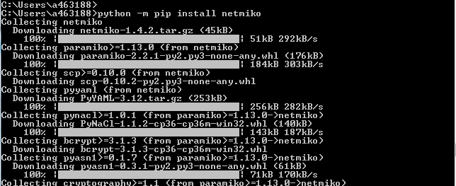
SSH To switch by Netmiko
We are using Netniko library package for SSH
This is not available by default, we need to install the library first
On Command prompt (cmd), type following command to install.
python -m pip install netmiko

Slide 35
SSH to a Device
This Script to take the SSH terminal of switch and display interface status
from netmiko import ConnectHandler
import getpass
import sys
device = {
'device_type': 'cisco_ios',
'ip': '192.168.43.10',
'username': 'username',
'password': 'password',
'secret':'password'
}
print ("Script for SSH to device, Please enter your credential")
device['username']=input("User name ")
device['password']=getpass.getpass()
device['secret']=input("Enter enable password")
net_connect = ConnectHandler(**device)
net_connect.enable()
output = net_connect.send_command('show ip int br')
print (output)

Slide 36
Back up configuration
Following script to take the output of show run and save in to a file
from netmiko import ConnectHandler
import getpass
import sys
import time
device = {
'device_type': 'cisco_ios',
'ip': '192.168.43.10',
'username': 'username',
'password': 'password',
'secret':'password'
}
ipfile=open("ip1.txt")
print ("Script for SSH to device, Please enter your credential")
device['username']=input("User name ")
device['password']=getpass.getpass()
device['secret']=input("Enter enable password: ")

Slide 37
Back up configuration -Contd
for line in ipfile:
device['ip']=line.strip("\n")
print("\n\nConnecting Device ",line)
net_connect = ConnectHandler(**device)
net_connect.enable()
time.sleep(2)
print ("Reading the running config ")
output = net_connect.send_command('show run')
filename=device['ip']+".txt"
saveconfig=open(filename,'w+')
print("Writing Configuration to file")
saveconfig.write(output)
saveconfig.close()
ipfile.close()

Slide 38
SSH- Set of Configuration command
Following script will take the set of command from file and push to devices
from netmiko import ConnectHandler
import getpass
import sys
import time
device = {
'device_type': 'cisco_ios',
'ip': '192.168.43.10',
'username': 'username',
'password': 'password',
'secret':'password'
}
ipfile=open("ip1.txt")
print ("Script for SSH to device, Please enter your credential")
device['username']=input("User name ")
device['password']=getpass.getpass()
device['secret']=input("Enter enable password: ")
configfile=open("configfile.txt")
configset=configfile.read()
configfile.close()

Slide 39
SSH- Set of Configuration command
for line in ipfile:
device['ip']=line.strip("\n")
print("\n\nConnecting Device ",line)
net_connect = ConnectHandler(**device)
net_connect.enable()
time.sleep(2)
print ("Passing configuration set ")
net_connect.send_config_set(configset)
print ("Device Conigured ")
ipfile.close()

Slide 40
Thanks

